Slide 1
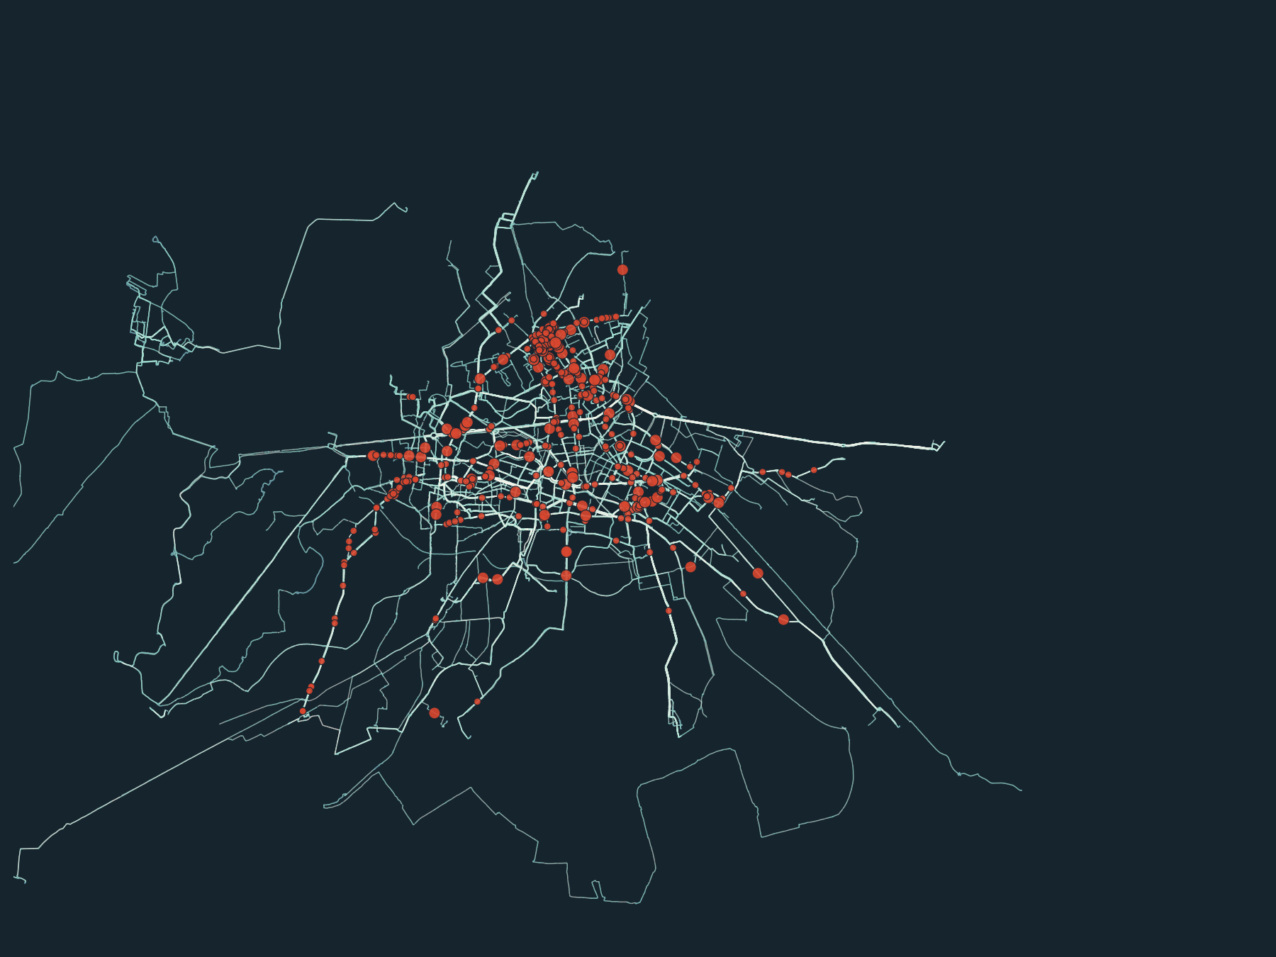
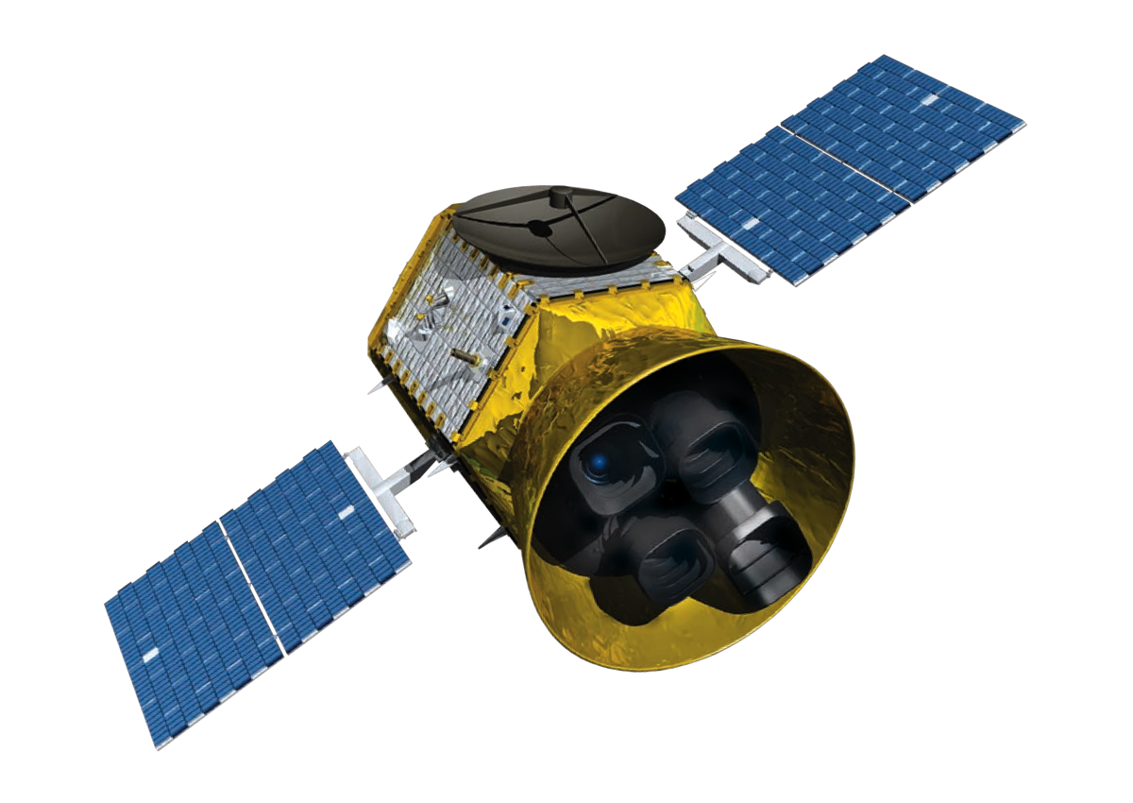
CSCI 4900/6000 · MIDTERM PRESENTATION
Mining Behavior Patterns from Cyclist GPS Trajectories
Speed, stops, turns and near-misses on Berlin's road network
Team 3: Steven Gobran & Kevin Yassa
Notes:
Hey everyone, I'm Steven, this is Kevin. Our project is about using GPS data from cyclists to figure out how people actually ride. Where they speed up, where they stop, and where things get dangerous. That map behind us is real data, it's every ride we cleaned."

Slide 2
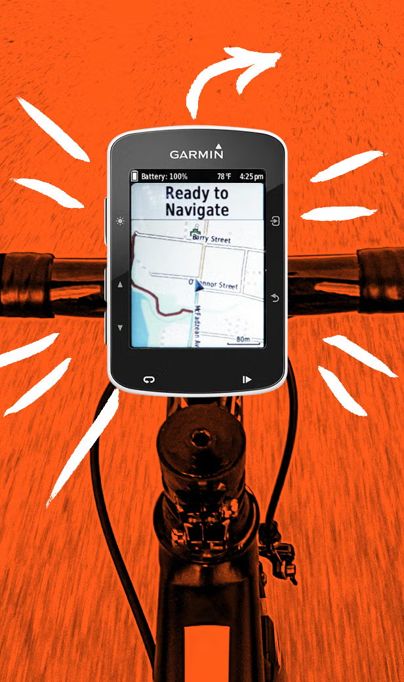
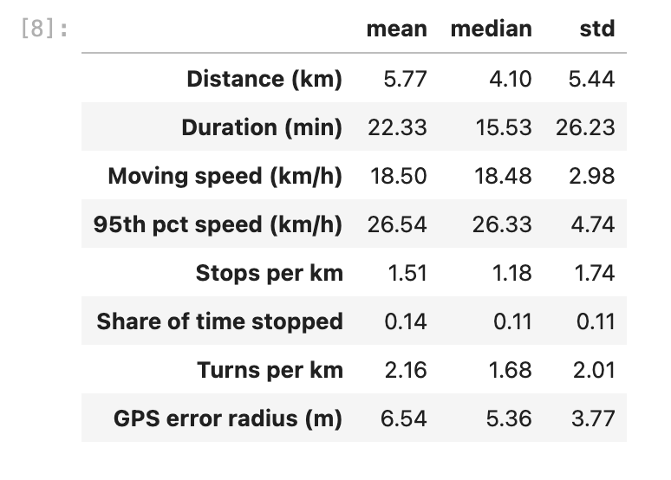
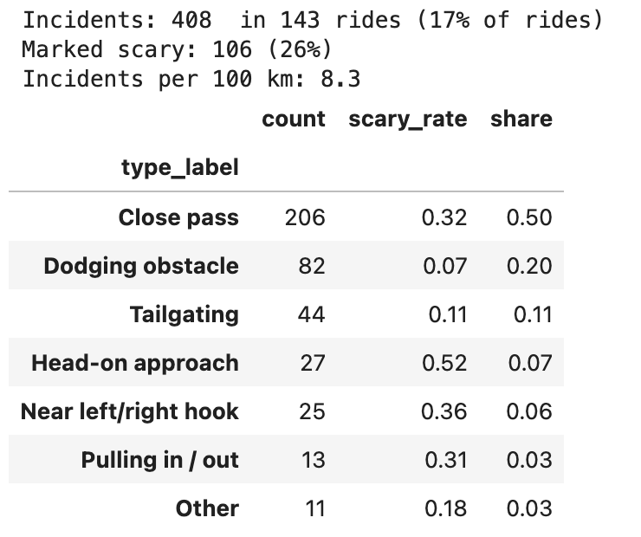
Problem and motivation
PROBLEM STATEMENT
Can we turn raw smartphone GPS traces into clear patterns of how cyclists ride: where they speed up, stop, turn, and run into danger?
WHY IT MATTERS
City planners mostly see counts of cyclists, not behavior. They rarely know which
streets riders actually use, where they slow down, or which junctions feel unsafe.
Who benefits: planners, traffic departments, and cyclists.
Notes:
What it is: The question we're answering. Cities usually know how many cyclists pass a spot (counters), but not how they ride. GPS traces can show that.
So the question is pretty simple. Can we take raw GPS from people's phones and turn it into real riding patterns? Right now most cities just count bikes. They don't know which streets people actually pick, where they keep stopping, or which intersections feel sketchy. That's the gap we're going after.

Slide 3
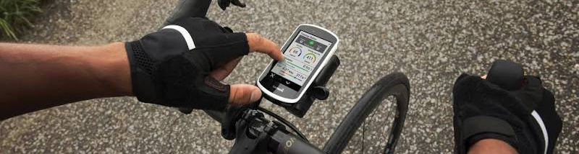
Objectives
01
02
03
04
Clean and map-match
Extract features
Find riding styles
Map hot spots
Snap noisy GPS points onto OpenStreetMap roads.
Speed, acceleration, stops and turns per ride.
Cluster rides into distinct riding styles.
Popular routes and junction hot spots.
Notes:
Our four goals.
Map matching means GPS points drift, so we snap them onto the actual road network (OpenStreetMap).
Features means turning thousands of points into a few numbers per ride.
Clustering means grouping similar rides.
Hot spots means summarizing by street and intersection.
Goals 2 and 3 are started. Goals 1 and 4 are the second half of the semester.
We've got four goals. First, clean up the GPS and snap it onto the real road network. Second, pull out features like speed, stops, and turns for every ride. Third, group rides into different riding styles. And last, find the popular routes and the problem intersections. For today we've got the feature part done and a first try at clustering.

Slide 4
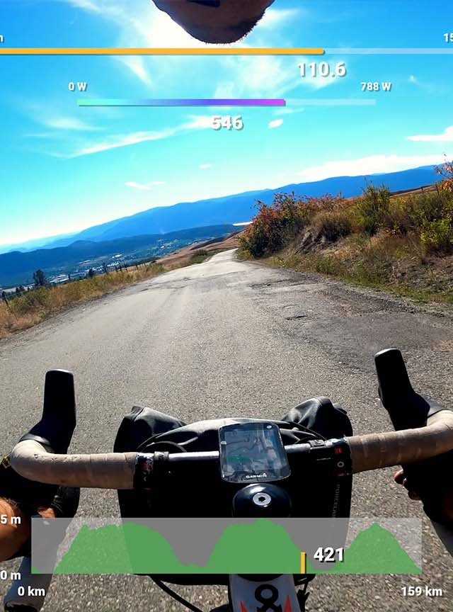
Cities where cyclists actually ride, stop and feel unsafe, so fixes go where they matter.
SOCIETAL IMPORTANCE
Berlin already shares SimRa data with its transport and environment department to reduce dangerous spots.
The same method works for any city with bike ride data, including Nashville.
Notes:
"Why does this matter? If a city knows exactly where cyclists stop and where they have close calls, they can fix those spots first instead of guessing. Berlin's actually already using this data. And honestly this could work for any city with bike data, Nashville included."

Slide 5
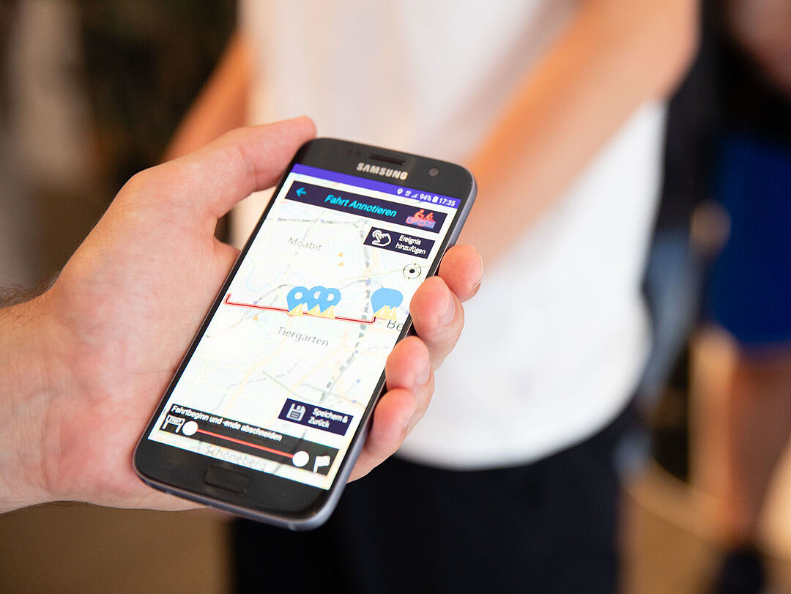
Data source: SimRa (TU Berlin)
A public, crowdsourced dataset. Cyclists record rides with the SimRa phone app and tag near-miss incidents afterward.
ONE RIDE FILE (TEXT, CSV BLOCKS)
Incident block
Recent rides on GitHub: github.com/simra-project/dataset
Older bulk releases on DepositOnce (2019 to 2025)
Secondary: OpenStreetMap Berlin road network (Geofabrik)
lat, lon, ts, bike, pLoc, incident, i1..i10, scary
For this midterm we analyzed one full monthly GitHub batch: the June 2023 upload.
Ride time series
lat, lon, X, Y, Z, timeStamp, acc, a, b, c
GPS about every 3 s; accelerometer and gyroscope rows in between
Plus a separate profile file per user (age group, experience)
Notes:
Our data comes from SimRa, a project out of TU Berlin. Cyclists use an app while they ride, and afterward they can tag any close calls, like a car passing too close.
Every ride file has two parts. On top are the incidents, and below that is the actual ride:
GPS about every three seconds, plus the phone's motion sensors.
For the midterm we took one full month, June 2023.

Slide 6
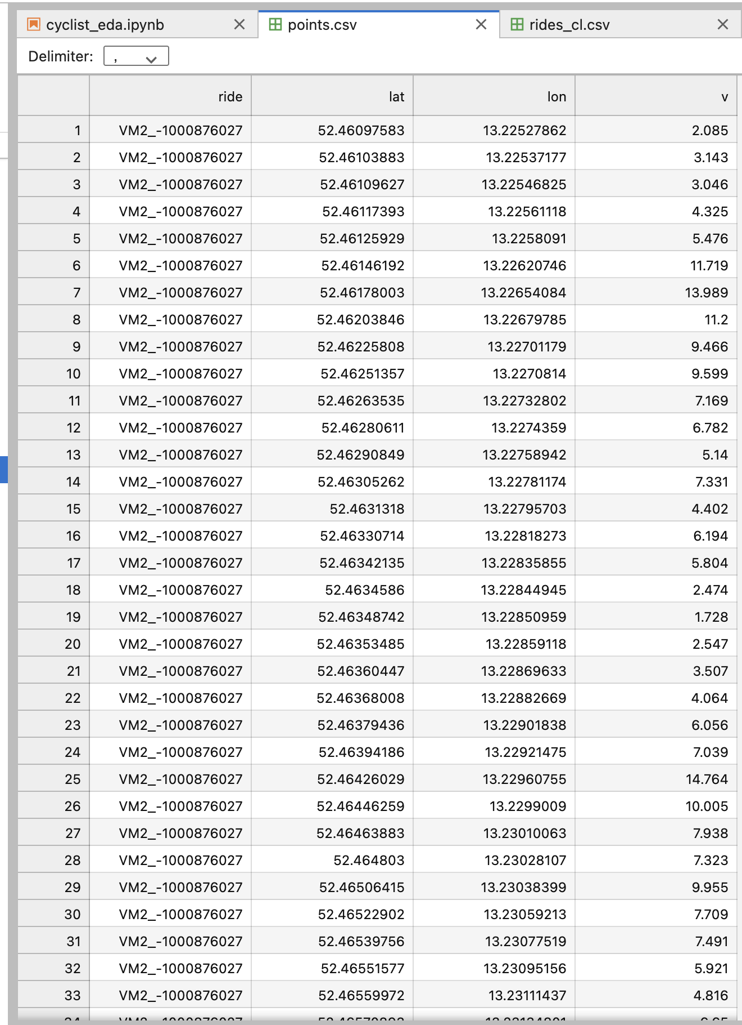
3 Data Files per month
1.) points.csv: every cleaned GPS point (used for the map)
2.) rides_cl.csv: one row per ride with speed, stops, turns, and cluster
3.) incidents.csv: every near-miss riders reported, with type and scary flag
Notes:
Points.csv

Slide 7
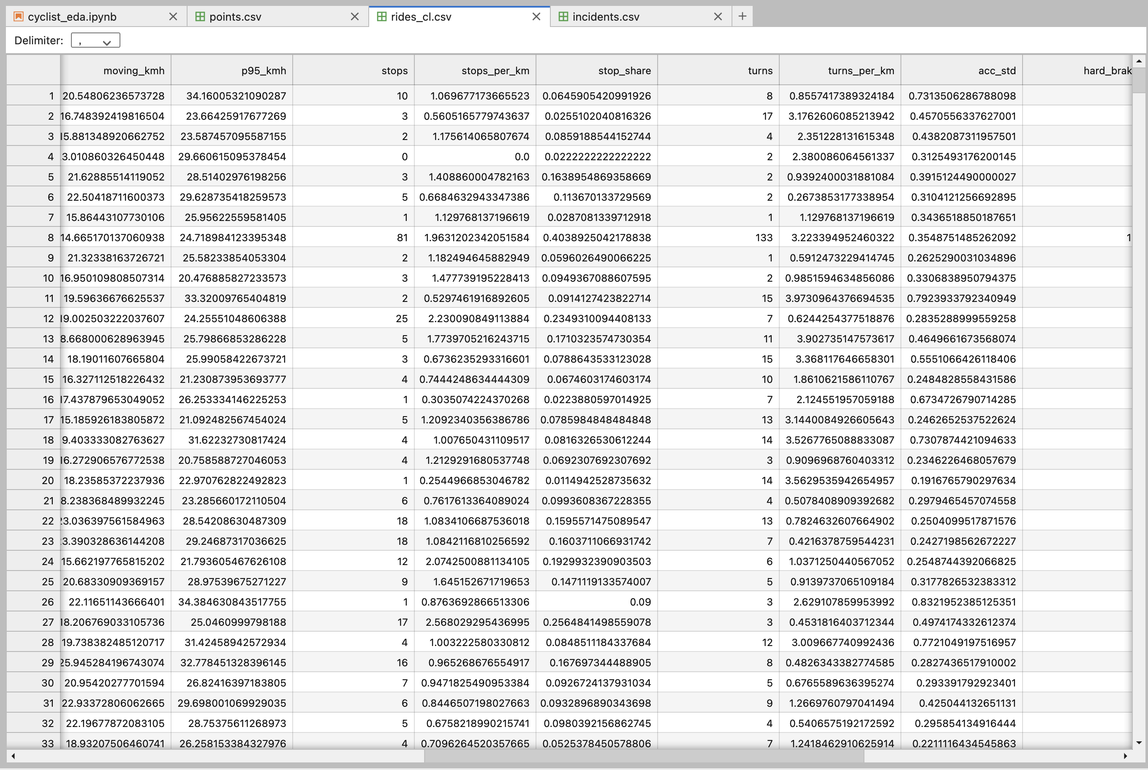
Notes:
Rides_cl.csv

Slide 8
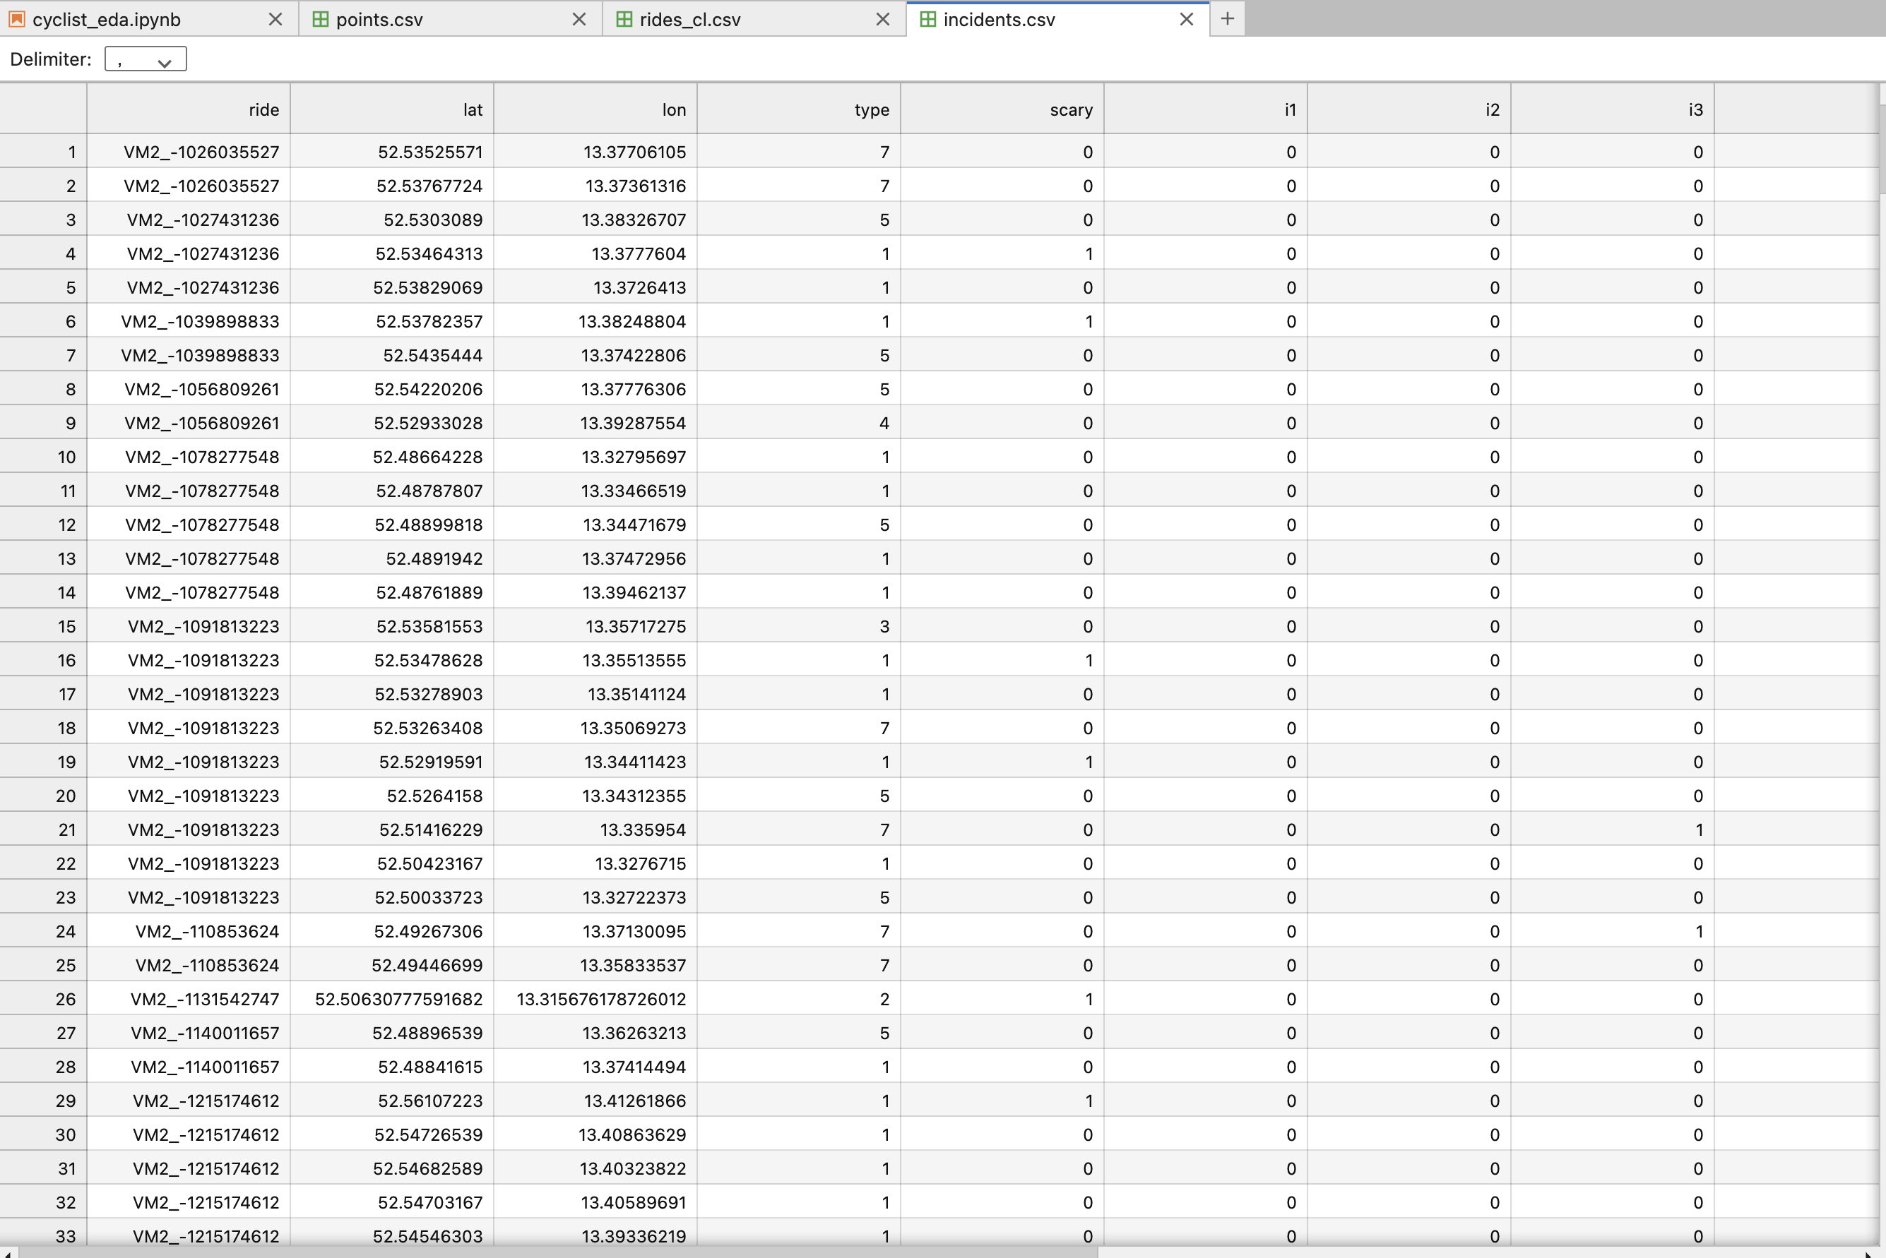
Notes:
Incidents.csv

Slide 9
Data description
877
4.57M
381K
408
ride files in the batch
raw sensor rows
GPS fixes
tagged incidents
Key variables
Ground truth
lat / lon, timeStamp, GPS accuracy radius (acc), accelerometer X/Y/Z, gyroscope a/b/c
Incident type (close pass, tailgating...), who was involved, and a scary flag. Plus bike type and phone position.
Structure: time series per ride (tabular CSV), joined to a road network graph for map matching. Full archive: 28K+ Berlin trips.
Notes:
Here's what we started with. 877 rides, about four and a half million rows.
Most of that is sensor data, only about 381 thousand rows are actual GPS points.
The important thing is we have ground truth. Riders labeled 408 incidents themselves, what type it was, who was involved, and whether it was scary.

Slide 10

Data cleaning
1
2
3
4
5
Split the file
Drop bad fixes
Remove spikes
Drop weak rides
Build features
Separate incidents from the ride series.
Remove 4,315 fixes with error over 20 m.
Drop 519 jumps over 54 km/h.
Drop 21 unreadable or tiny rides.
Speed, stops, turns, braking per ride.
Result: 856 clean rides, 375K GPS points, 4,936 km of riding.
Every fix comes with an error radius. Phones often land 5 to 20 m from the true spot, so we filter first and map-match next.
Notes:
Phones make GPS mistakes, so we filtered out the junk.
Error over 20 m: every GPS point comes with an accuracy radius. Past 20 m, the point could be on the wrong street entirely.
Jumps over 54 km/h: a bike can't go that fast in a city, so those are GPS glitches.
Rides under 300 m or 2 minutes: probably someone testing the app.
Stops: 5 or more seconds below walking speed. Turns: the direction changes by more than 45 degrees while moving.

Slide 11
Summary statistics (856 rides)
Feature | Mean | Median | Std dev
Distance (km) | 5.77 | 4.10 | 5.44
Duration (min) | 22.3 | 15.5 | 26.2
Moving speed (km/h) | 18.5 | 18.5 | 3.0
95th pct speed (km/h) | 26.5 | 26.3 | 4.7
Stops per km | 1.51 | 1.18 | 1.74
Share of time stopped | 14% | 11% | 11%
Turns per km | 2.16 | 1.68 | 2.01
GPS error radius (m) | 6.5 | 5.4 | 3.8
Notes:
So what does a normal ride look like? About 4 kilometers, 15 minutes, around 18 and a half kilometers an hour when they're actually moving. Notice distance and duration have a mean higher than the median. That's because a few people did really long rides and it pulls the average up. That's why we lean on the median.

Slide 12
Where the rides go
856 rides plotted from raw GPS. Brighter lines are faster riding.
Red dots are the 408 tagged incidents. Larger ones were marked scary.
Incidents cluster in the dense inner city, along the same corridors most riders use.
Notes:
This is every ride plotted on Berlin. Brighter lines mean faster riding. The red dots are incidents, and the bigger ones were marked scary. You can see they bunch up in the middle of the city, along the same main roads most people ride. So the danger isn't random, it follows the traffic.

Slide 13
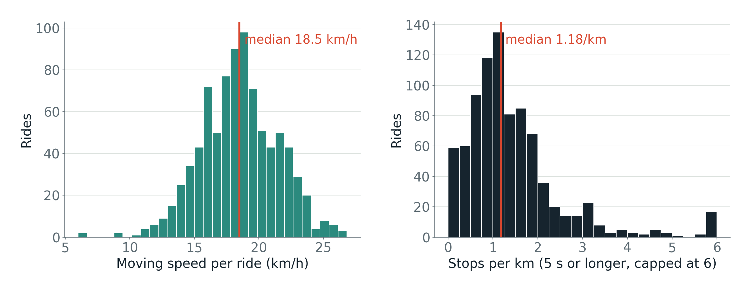
Speed and stopping
Speed is close to bell-shaped around 18.5 km/h. Stops are right-skewed: most rides stop about once per km, a few stop constantly.
Notes:
Two histograms. A histogram shows how many rides fall in each range.
Speed is bell-shaped around 18.5 km/h, so most people ride at similar speeds.
Stops have a long tail: most rides stop about once per km, but some stop constantly.
That tail is the first hint of a "stop-and-go" riding style.

Slide 14
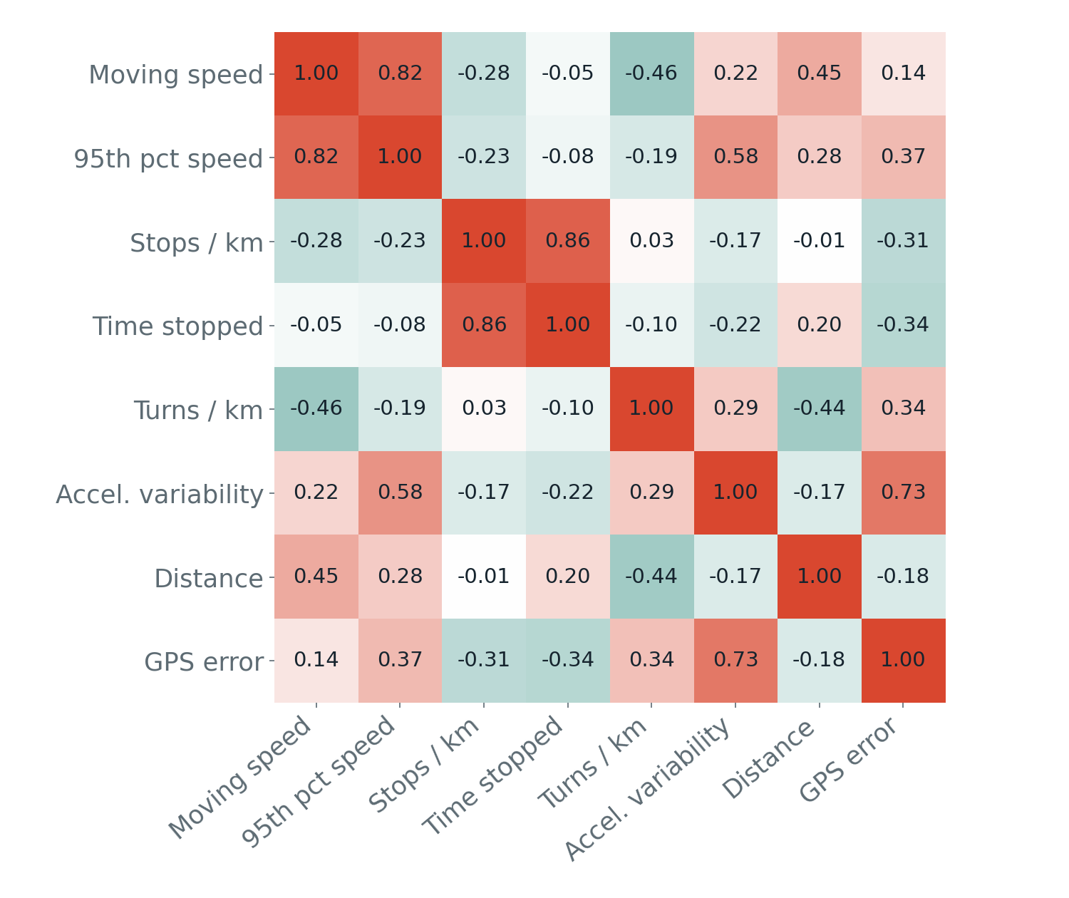
How the features relate
More turns, slower riding
Turns per km vs moving speed: −0.46
Stops drive time lost
Stops per km vs share of time stopped: 0.86
GPS noise leaks in
Acceleration variability vs GPS error: 0.73. Some "jerky" riding is really a bad signal.
Notes:
This shows which features move together. More turns goes with slower riding, which makes sense. Stops and time stopped are basically measuring the same thing. But the one we want to point out is this red one. Acceleration lines up with GPS error. That tells us some of what looks like jerky riding is really just bad GPS. That's a problem we have to fix before the final."

Slide 15
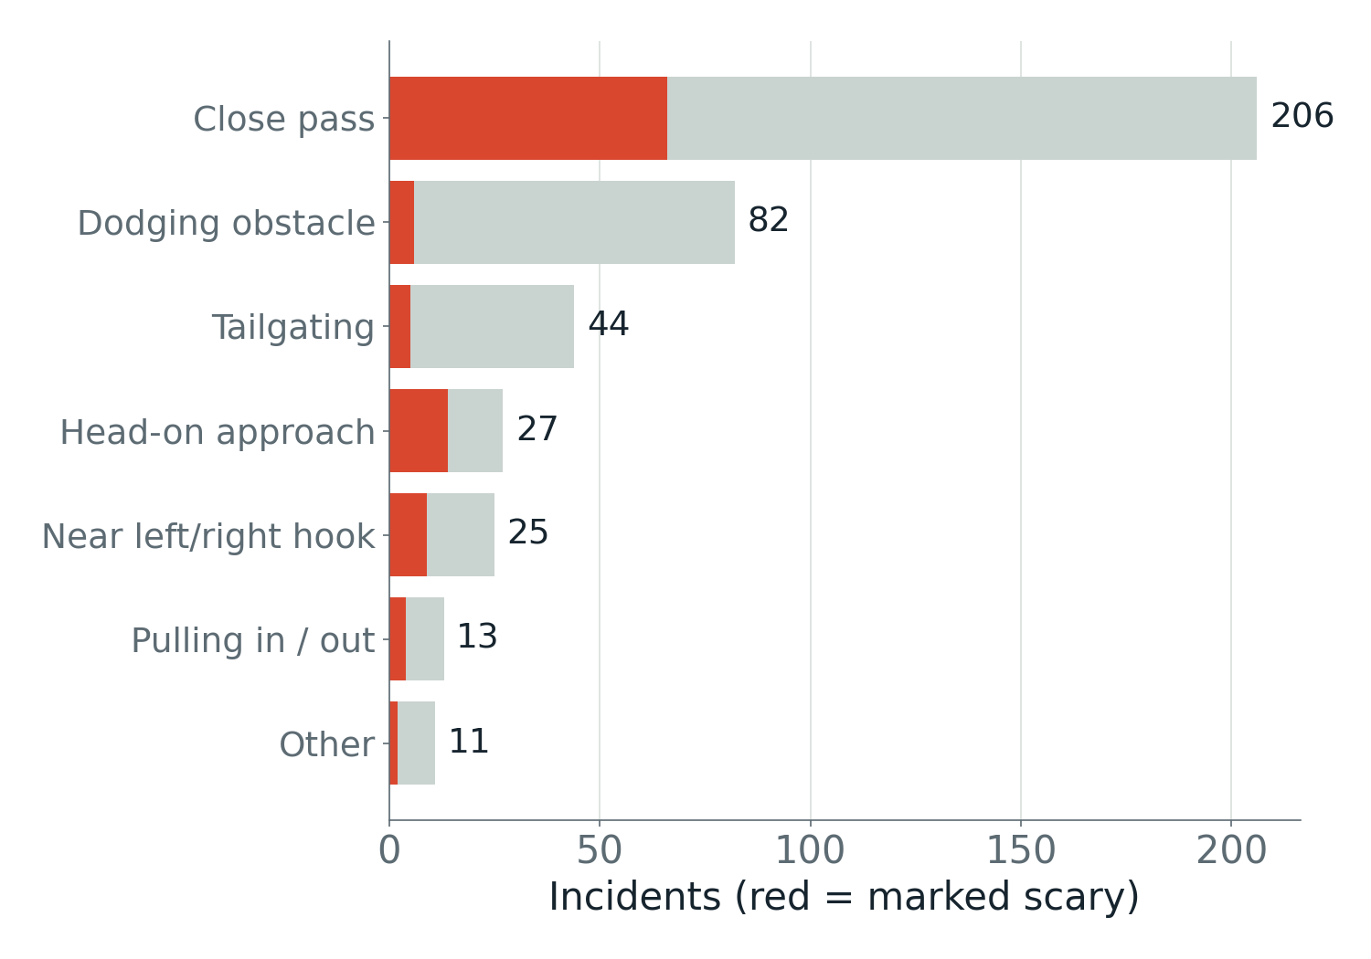
Near-miss incidents
50%
of incidents are close passes
73%
involve a car
8.3
incidents per 100 km ridden
Head-on approaches are rarer but the scariest (52% flagged).
Notes:
Now the incidents riders reported. Half of them are close passes, basically a car squeezing by. Almost three out of four involve a car. On average that's about 8 incidents every 100 kilometers. And head-on ones don't happen much, but when they do, over half the time the rider said it was scary

Slide 16
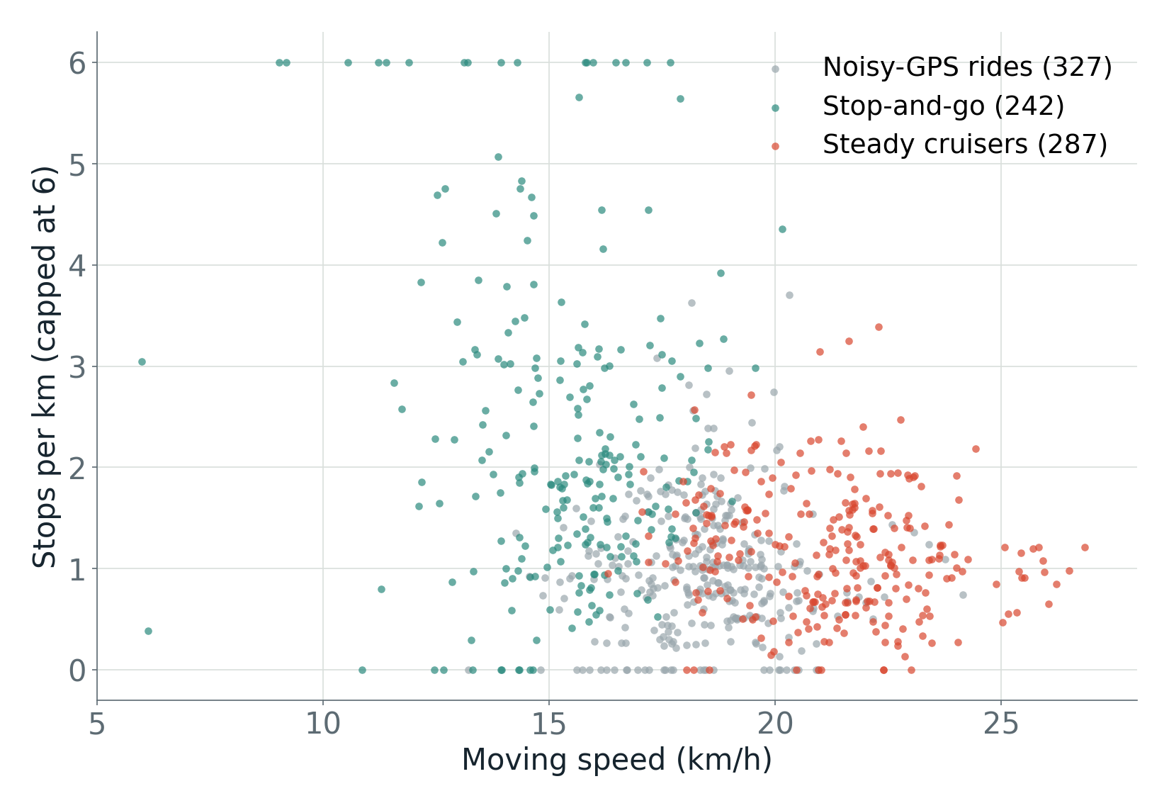
First look at riding styles
Steady cruisers (287)
Fastest, 21.4 km/h, few turns, longer rides.
Stop-and-go (242)
Slowest, 15.6 km/h, about 2 stops per km.
Noisy-GPS rides (327)
96% had the phone in a pocket. A data artifact, not a style.
Preliminary k-means (k = 3) on 6 standardized features. Silhouette 0.25, so groups overlap.
Notes:
Then we tried grouping the rides. Two groups actually make sense: steady cruisers, who are fast with few stops, and stop-and-go riders. But the third group was weird. 96 percent of those people had their phone in their pocket. So that group isn't a riding style, it's bad GPS. That's actually useful, because it tells us exactly what to fix next."

Slide 17
Sources
Main dataset (what the python notebook uses)
SimRa dataset on GitHub: https://github.com/simra-project/dataset
The exact folder I pulled: Berlin_2023_06 in that repo (877 ride files, the June 2023 batch)
legend.txt in the same repo explains the codes for bike type, phone position, incident type and who was involved
Related
SimRa GitHub org (the app and other project code): https://github.com/simra-project
SimRa dashboard (good for a screenshot or showing hot spots): https://simra-project.github.io/dashboard/
Older bulk releases on DepositOnce (from your proposal): https://doi.org/10.14279/depositonce-10605 through https://doi.org/10.14279/depositonce-22968
OpenStreetMap Berlin road network for map matching (Geofabrik): https://download.geofabrik.de/europe/germany/berlin.html
Notes:
These are our sources

Slide 18






Next steps
Map-match all rides to the OSM Berlin network
Smooth GPS and control for phone position
Scale up to more monthly batches and years
Re-cluster, then summarize by street segment and junction
Notes:
Final Summary
Typical ride: about 4 km and 15 minutes, at about 18.5 km/h while moving. Distance and duration are right skewed.
Stops: most rides stop about once per km, but a long tail of rides stop constantly (stop-and-go riding).
Turns slow riders down: more turns per km goes with lower moving speed.
Near-misses: about half are close passes, most involve a car, and head-on approaches are the scariest.
GPS noise is a real problem: acceleration variability tracks GPS error closely, and one of the three clusters is driven by phone position (almost all in a pocket), not by riding style.
Next steps: map-match rides to the OpenStreetMap Berlin network, smooth GPS and control for phone position, scale up to more batches, then re-cluster and summarize by street segment and junction.

